Slide 1
Substance abuse among teens
Julianne Haddad, LMSW
Presenter: Kyle & Haley from The Pathway Program

Slide 2
Resource https://thepathwayprogram.com/

Slide 3
Haley’s story

Slide 4
A Growing Trend
Abuse of prescription drugs not prescribed for the teen taking them is a growing trend in the U.S.
Many teens believe prescription drugs are not as dangerous as illegal drugs
Approximately 1 out of every 5 teens has taken prescription drugs not prescribed for them

Slide 5
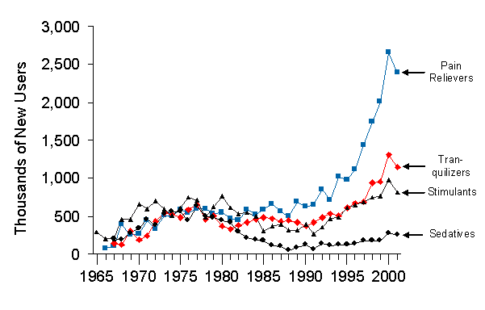
Number of New-Medical Users of Therapeutics

Slide 6
Reasons for Use
Manage and regulate their lives
Increase energy
Increase ability to focus
Cope with academic, social or emotional stress
Lose weight or “bulk up”

Slide 7
Medications can help us when used as directed by a healthcare professional
Let’s begin by establishing the beneficial impact of prescription medications.
1. Prescription medications can help us lead longer and healthier lives when used under the supervision of a healthcare professional, like a pharmacist or doctor.
2. Our life expectancy is the longest in history, and people are now able to live with many diseases that were once fatal.
3. We are preventing or curing many illnesses and relieving troublesome symptoms, in part, because of prescription medications.

Slide 8
Which Scenario Represents Prescription Drug Misuse?
1. Here are three scenarios. Scenario 1: an individual takes medication to help them study. Scenario
2: an individual prescribed an opioid pain medication is in severe pain—the patient takes more than instructed to manage their pain. Scenario 3: an individual shares their prescription medication with a friend. 2. Which scenario do you think represents prescription drug misuse? Note to facilitator: Encourage participants to discuss amongst themselves which scenario(s) represent prescription drug misuse. When ready, poll the audience.

Slide 9
Misusing Medications is:
Therefore, we define prescription drug misuse as engaging in primarily three behaviors:
1. Taking more of a prescription medication than prescribed.
2. Taking a prescription medication for a reason different than
prescribed.
3. Sharing or taking someone else’s prescription medication.

Slide 10
Drugs of Abuse
Opioids and other pain killers
Stimulants
Anti-anxiety drugs
Sedative/hypnotics
Feel good drugs (antidepressants)
Look good drugs (steroids)
Feeling goofy drugs (psychedelics)

Slide 11
Risks of Prescription Drugs
Addiction
Overdose
Exhaustion and/or confusion
Abnormal heart rhythms
Psychosis- with addiction or withdrawal
Prevent learning of healthy coping skills

Slide 12
Facts about prescription drug misuse
1. Drug overdose deaths, primarily from prescription medications, is the leading cause of accidental death in the U.S. Clearly misusing prescription medications can be harmful to your health. In addition, selling or taking someone else’s prescription medication is a felony offense and punishable by jail time.
2. The most commonly misused prescription drugs include opioid pain medications (e.g. Vicodin, OxyContin), sedatives (e.g., Xanax, Valium) and stimulants (e.g., Adderall, Ritalin)

Slide 13
Factors that Fuel the Problem
1. Drug-taking Culture: We are a drug-taking society, and the use of medications has become normalized in our culture.
2. Easy Access: Because we are using medications at unprecedented rates, they are relatively easy to obtain without a prescription. In fact, data from the National Survey on Drug Use and Health demonstrates that the majority of individuals that misuse a prescription drug get them from family members or friends
3. Media: We are only one of two countries (other is New Zealand) that permit direct-to-consumer advertisements for prescription medications. These advertisements fuel our false beliefs that medications provide quick fixes to everyday problems.

Slide 14
Factors that Fuel the Problem
4. Mixing Drugs: Misperceptions also exist regarding the dangers of mixing prescription medications with alcohol. Many overdoses result from mixing prescription medications with alcohol or with other drugs.
5. Pressures facing youth: Like adults, many youth misuse prescription medications to deal with various pressures they experience. Pressures may include managing daily stress and anxiety or perhaps pressure to perform at a high level either in athletics or in academics.
6. Issues of care: In some situations, healthcare professionals may not be educating patients on the safe use of the medications prescribed to them following a surgery or treatment of a medical condition. This lack of education can lead to misuse.

Slide 15
Using Medications Safely
You can easily make a difference by incorporating three safe medication practices into your daily life: Follow instructions, keep for yourself
Follow Instructions:. Instructions are provided to keep us safe. When we don’t follow instructions, we increase the likelihood that negative side effects, including developing a dependency on some medications, can occur.
Keep for Yourself: our genetics, existing medical conditions, current medications we may be taking, even our age and weight, can all determine how we respond to medication. And that includes not only how we respond to the therapeutic effects, but also to the negative side effects that can be harmful. Genetic risk factors that increase the propensity to develop a physical dependency or addiction to a drug do exist—how your friend’s body handles a medication is not telling of how your body will handle the same medication

